Slide 1
Cobden Farm Quarry – Update presentation to Little Budworth Parish Council 09.01.2019
Agenda
Tarmac update
Quarry Managers Update:
Quarry Development & Restoration
Noise Monitoring
Dust Monitoring
HGV movements
3. Estates Managers update

Slide 2
Quarry Managers Report - Steve Williams
Output 2018 – 108,000t (Feb – Dec)
Projected output 2019 – 156,000t
Remaining life estimated 2 - 2.5 years.
Planning end date September 2021
Sand / Limestone grit blending tonnage = 1,057

Slide 3
Development and restoration 2018
2018 Restoration

Slide 4
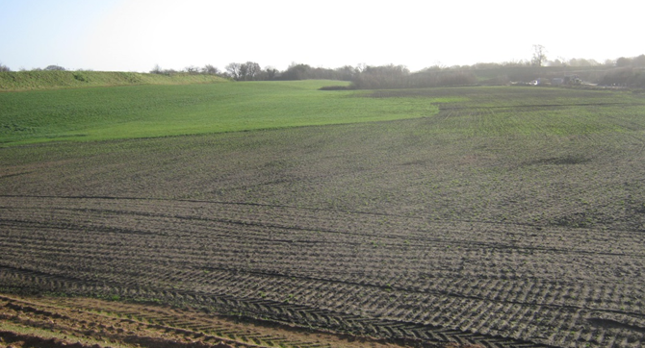
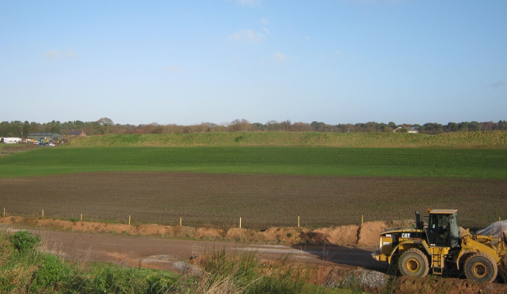

Slide 5
Working and Restoration 2018
Prior to the earthmoving, the land is assessed by an ecologist for ground nesting birds – Works were suspended due to Skylarks during the 2018 soil stripping
All soil stripping is undertaken under an archaeological watching brief – Nothing of interest has been found to date.

Slide 6
Noise Monitoring Locations

Slide 7
Noise Monitoring Results 12th September 2018

Slide 8
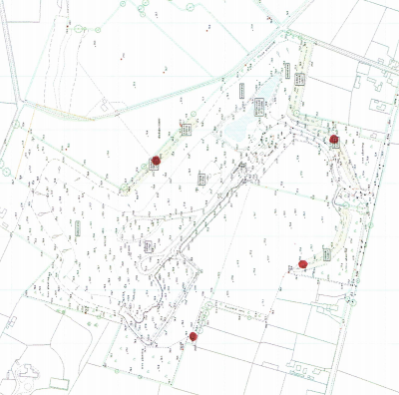
Dust Monitoring Locations
1
4
3
2

Slide 9
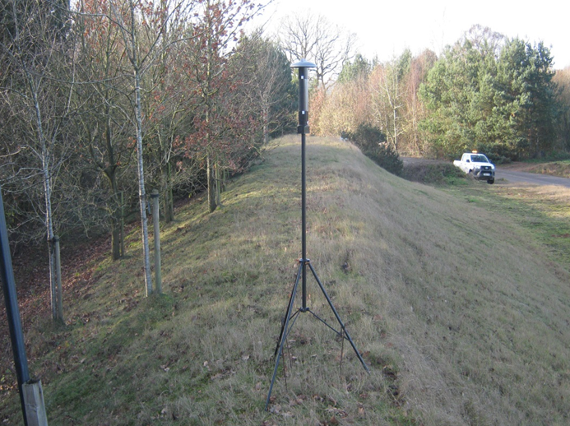
Dust Monitor

Slide 10
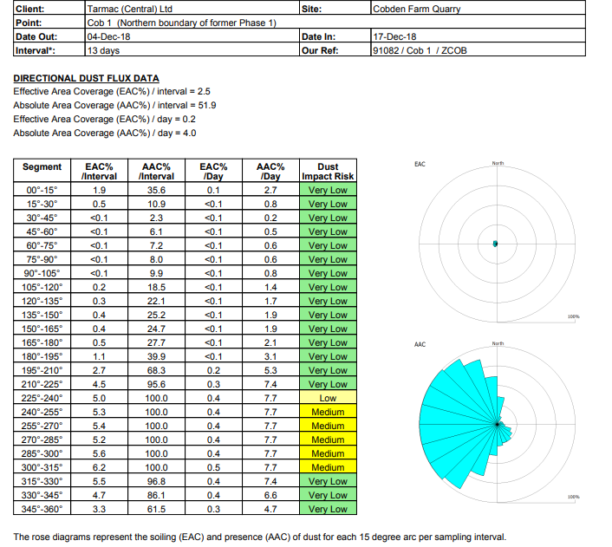
Noise Monitoring Results

Slide 11
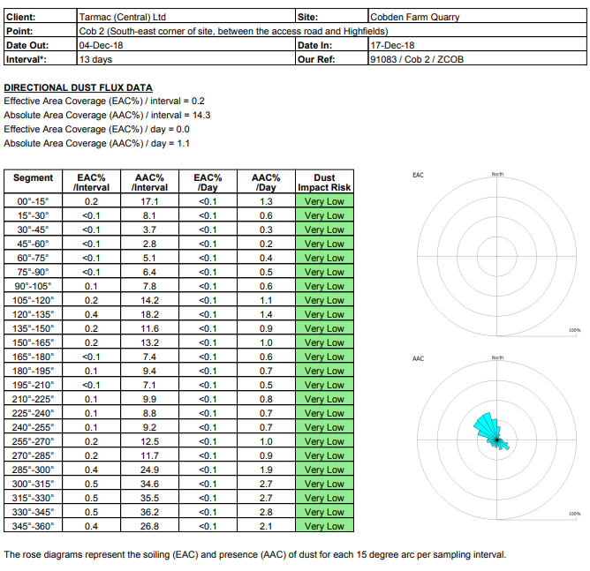

Slide 12
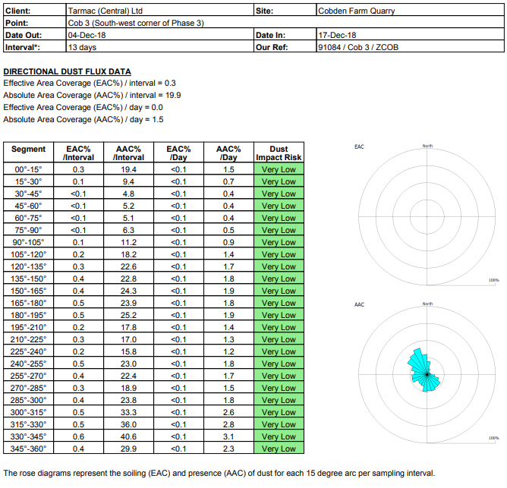

Slide 13
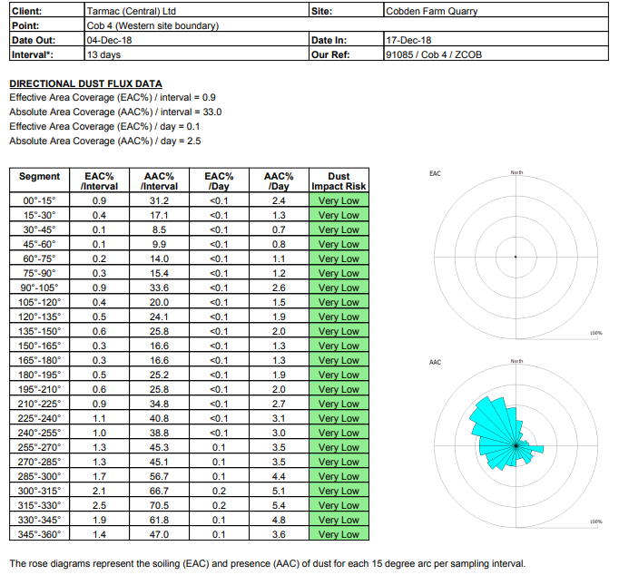

Slide 14
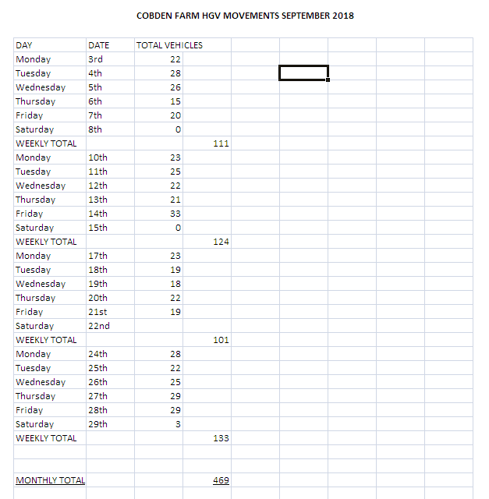

Slide 15
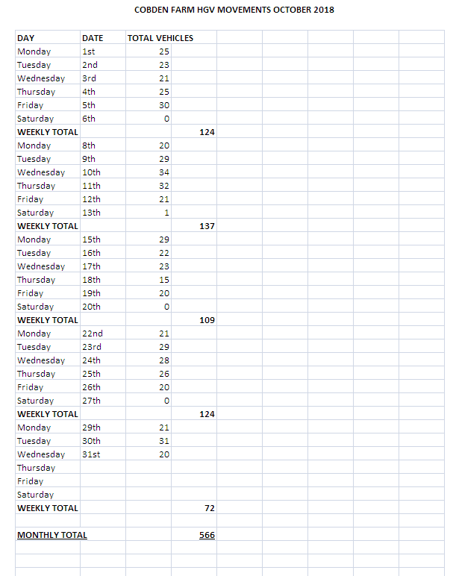

Slide 16
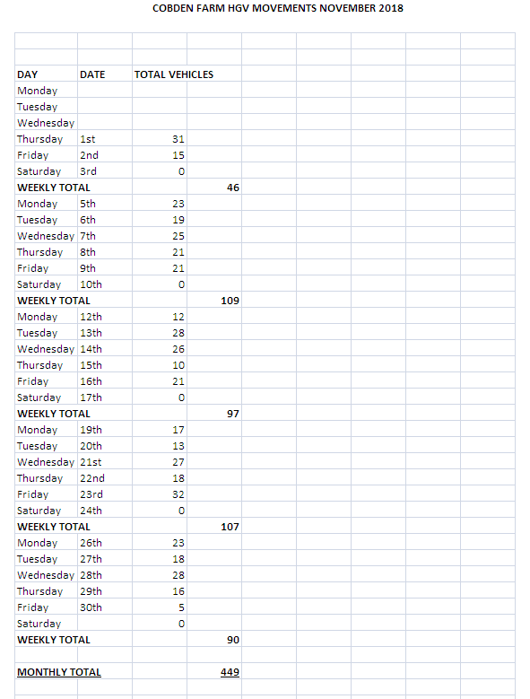

Slide 17
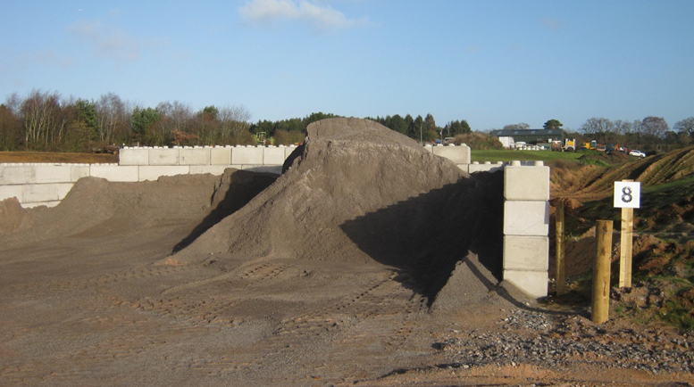
Estates Managers Report Planning permission granted for the importation of Limestone grit and erection of mobile concrete section bay – Approved 6th November 2018.

Slide 18
Estates Managers Report (cont) Exploratory Drilling to south of A54 took place Oct/nov 2018. Full analysis is still awaited although initial indications are that the sand is very similar to cobden Farm. Should the investigation prove a viable deposit, proposals will be developed and presented to the parish council and residents. We will continue to investigate potential sand deposits around cheshire.

